Slide 1

6 Ways technology is
Changing Education
For the better
A publication of

Slide 2


If we teach today as we taught yesterday, then we rob our children of tomorrow.
– John Dewey

Slide 3
Breaking down the traditional barriers of the school system, technology has led to revolutionary changes in the education sector.

Slide 4
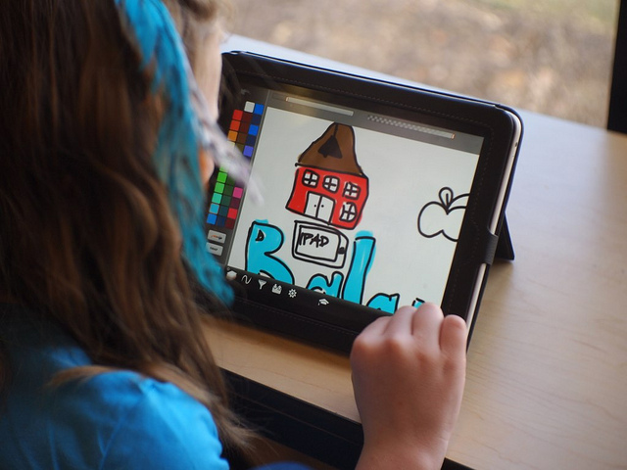
Brad Flickinger / CC BY 2.0
1. It’s Making Learning Personal

Slide 5
Technology makes it possible to reach every single student on a personal level, delivering personalized resources and a personalized learning experience to every single student.

Slide 6
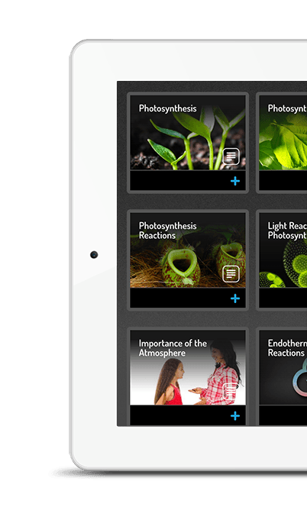
Fishtree does this by assessing students’ Learning DNA, generating resources specific to their needs, and tracking student progress on a continuous basis, with instant help at hand.

Slide 7

Steven Depolo) / CC BY 2.0
2. It’s Making Learning Adaptive

Slide 8
Adaptive learning keeps the focus on the students, moving with their rhythm, adapting to their every need. Technology has allowed us to keep students learning at their own pace, in their own way, tailoring the learning experience as it continues.

Slide 9
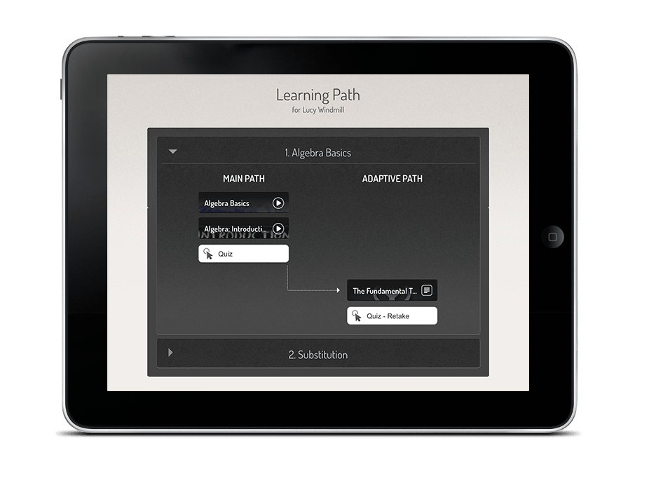
Fishtree’s adaptive platform identifies a student’s learning path, provides tailored resources, tracks a student’s learning, and ensures every specified target is reached.

Slide 10
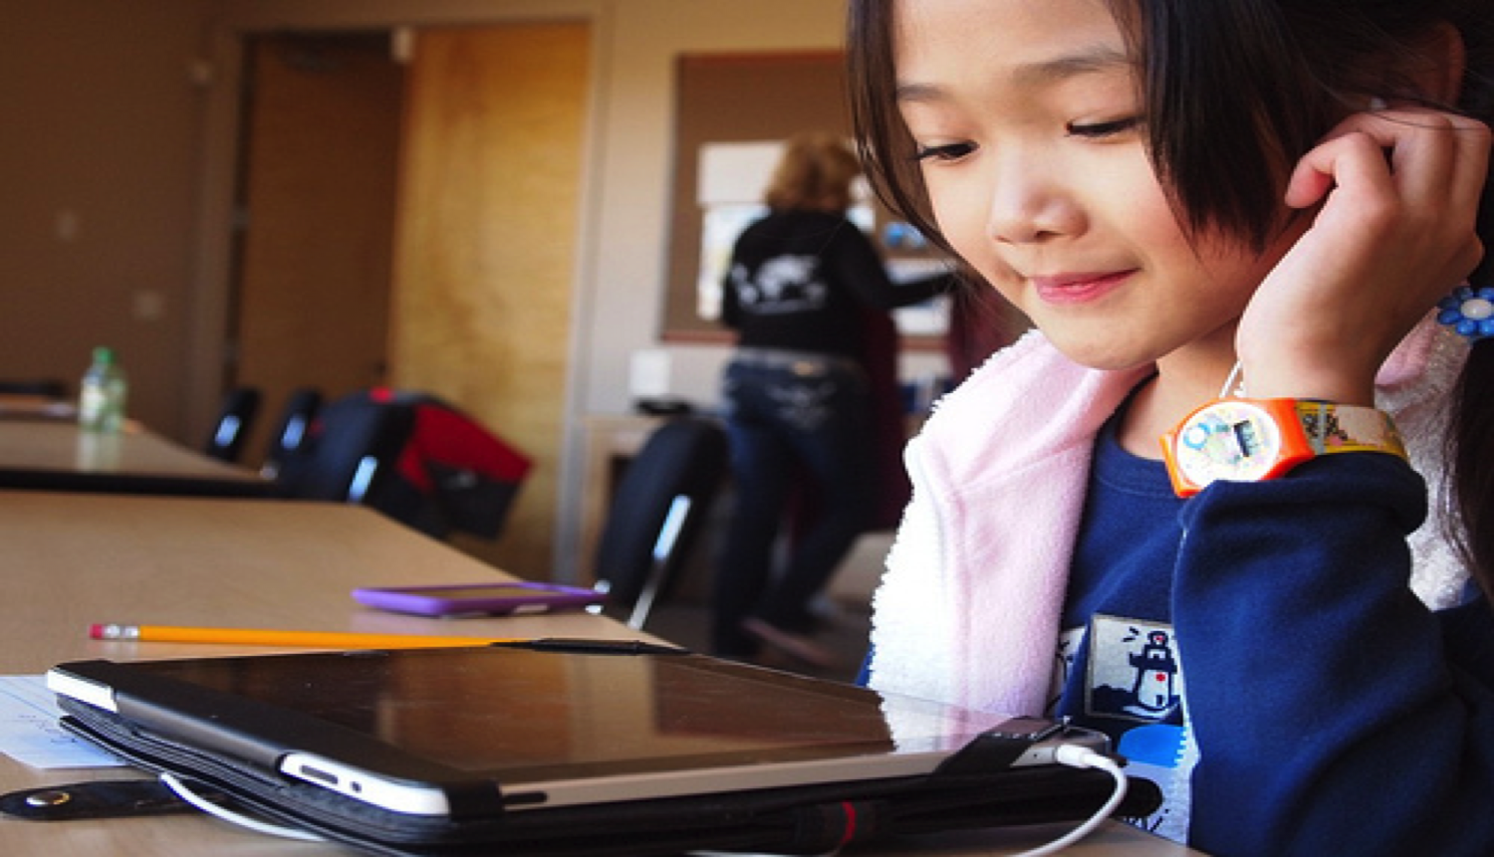
Brad Flickinger / CC BY 2.0
3. It’s Making Learning Mobile

Slide 11
Through the use of mobile technology like Fishtree, educators can keep students learning long after leaving the school gates. With personalized resources and lessons, students are encouraged to indulge in independent learning and self-assessment, fueling their creativity and critical thinking skills.

Slide 12
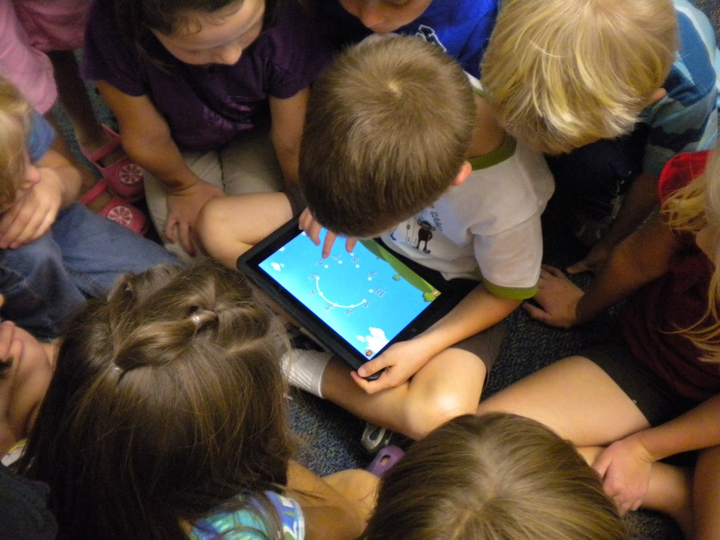
4. It’s Making Learning Social
www.audio-luci-store.it / CC BY 2.0

Slide 13
In a world increasingly dominated by social media, encouraging digital citizenship is more important than ever. Technology has given us the key to bringing the social aspect into learning, along with the added bonus of keeping educators, students, and peers connected.

Slide 14
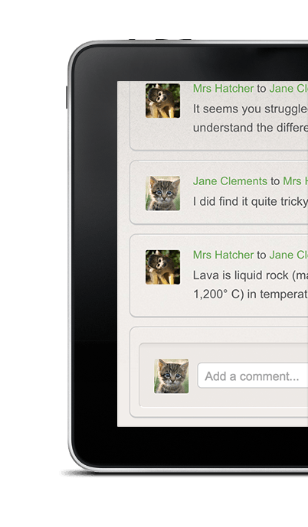
Fishtree gives educators and students a safe, monitored, social media-based feature that encourages open, respectful collaboration at all times.

Slide 15

5. It’s Making Learning Transparent
www.audio-luci-store.it / CC BY 2.0

Slide 16
Technology is providing educators with complete transparency into the learning process. With the help of technology, we can now see exactly how each student is learning, using what resources, and at what pace.

Slide 17
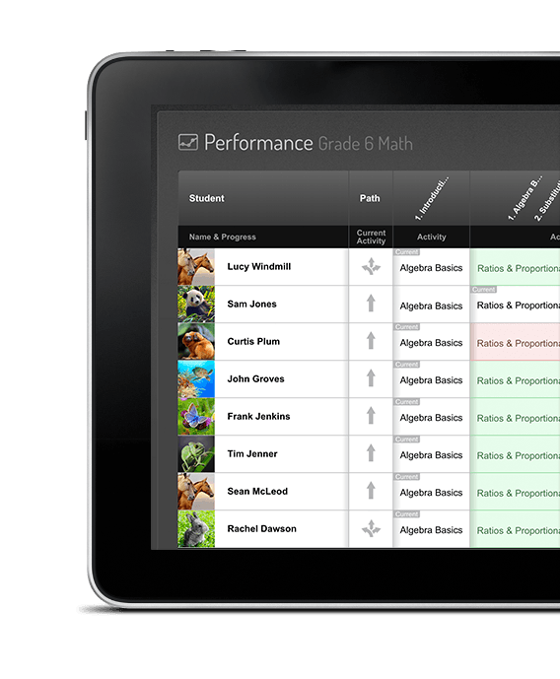
Fishtree provides key insights into student learning, identifying the specific path taken by each, and translating the personalization process step-by-step.

Slide 18

6. It’s Making Teaching Easier
www.audio-luci-store.it / CC BY 2.0

Slide 19
Simultaneously acting as counsellor, parent, educator and nurturer is not an easy job. Technology can take the pressure off by tracking student progress and performance for you, building an organized system of student portfolios.

Slide 20
Fishtree offers a lesson planner with millions of standard-aligned resources at the ready, saving a lot of precious time. While it could never replace the key instructor in the classroom, technology acts to make the process a whole lot easier.

Slide 21
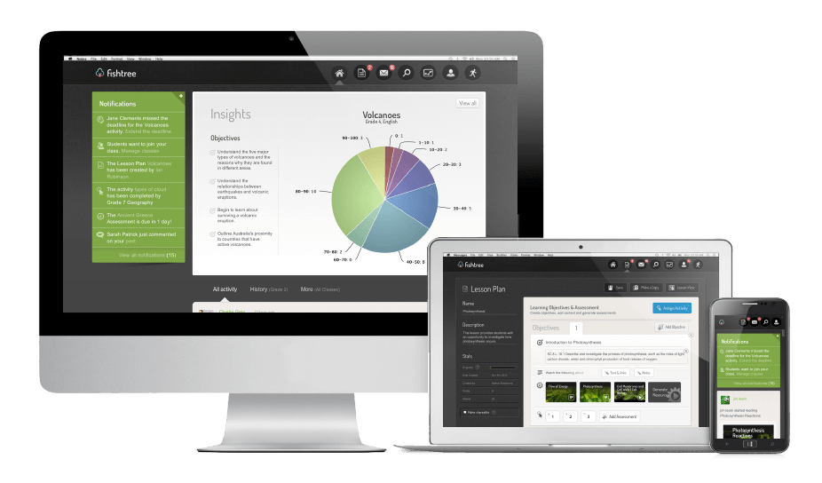

What Else Can Fishtree Do?
Introducing the Next Gen Learning Platform

Slide 22
Other Key Features
Content Curation – Fishtree offers a dynamic library of resources, including real-time media, that are automatically standard-aligned, lexile-leveled, and tailored to each lesson.
Lesson Planning – Fishtree’s lesson planner is simple and effective, allowing teachers to create engaging lessons in minutes
Collaboration – The social media-based collaboration feature allows students and teachers to work together in a safe environment.

Slide 23
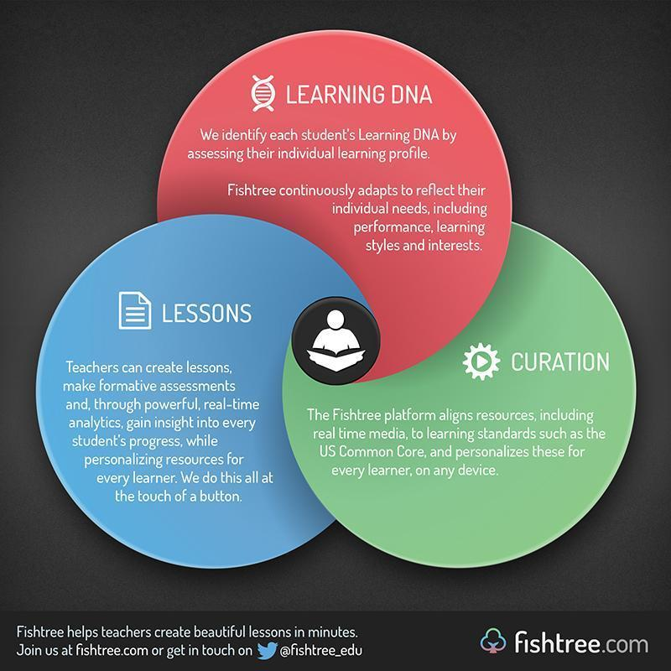
Try the next generation learning platform for FREE at fishtree.com and discover the possibilities for yourself.

